Slide 1
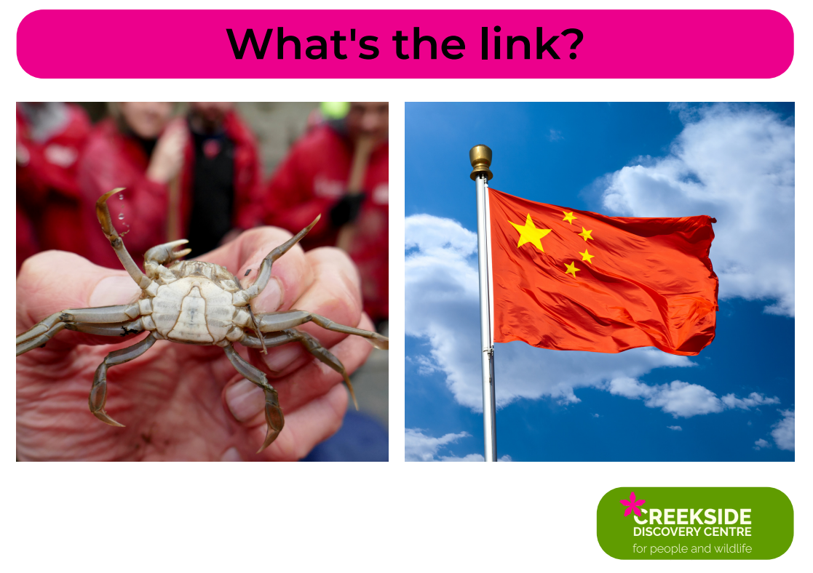
Notes:
The Chinese Mitten Crab is native to eastern Asia and has hitch-hiked it’s way all around the world!

Slide 2
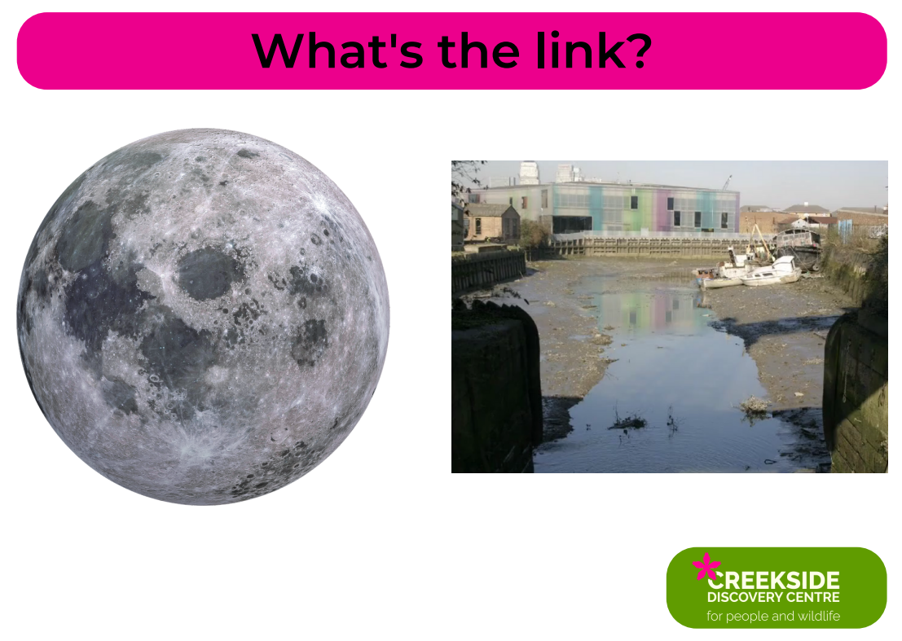
Notes:
The moon controls the tides in Deptford Creek

Slide 3
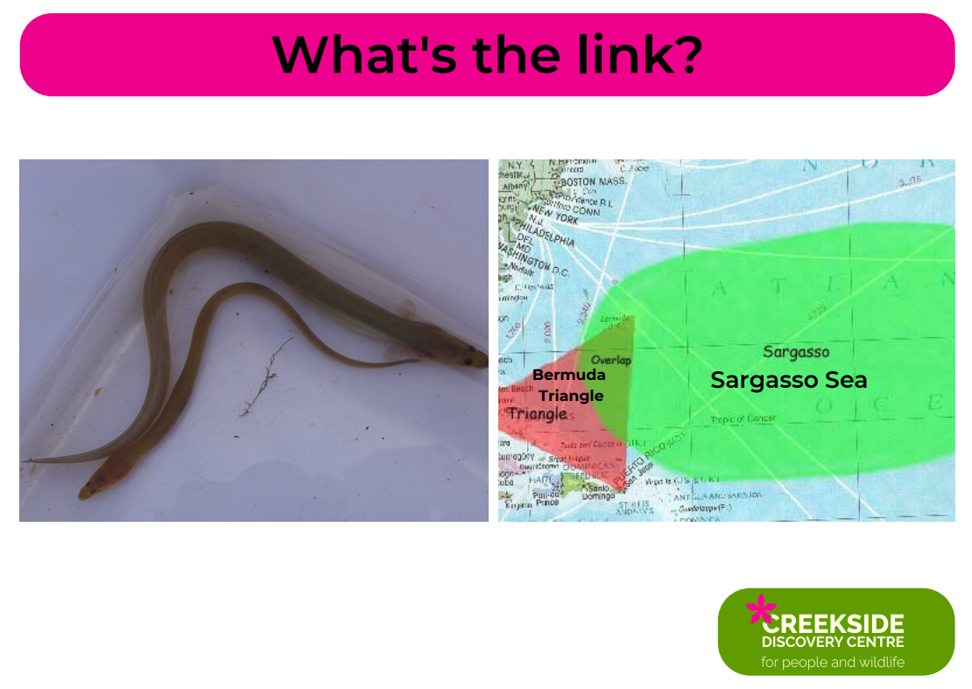
Notes:
The European Eel travels all the way from it’s breeding ground in the Sargasso Sea near Bermuda, to rivers like Deptford Creek to grow and mature!

Slide 4
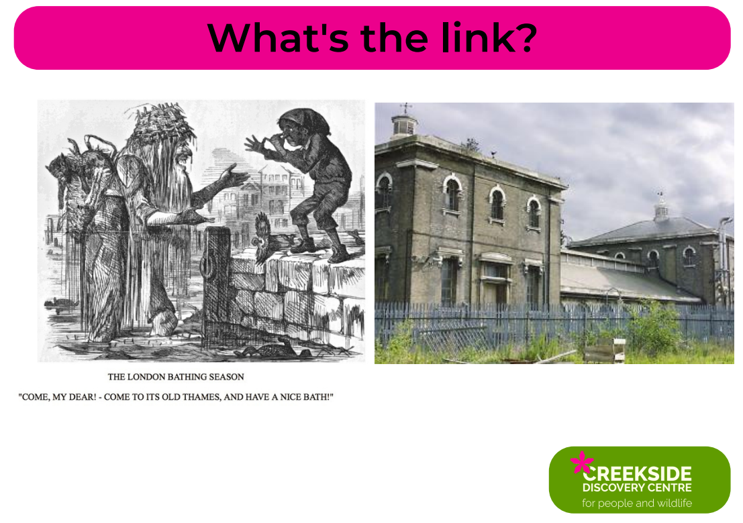
Notes:
The Thames used to be so polluted that people drew cartoons making fun of it – until a sewer system was built in the 1860s

Slide 5
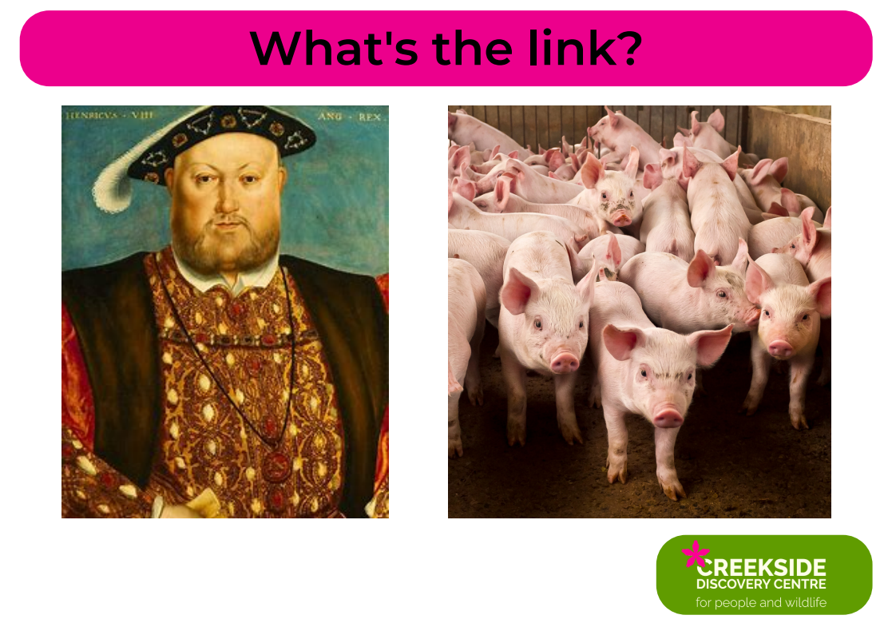
Notes:
King Henry VIII had a slaughterhouse near Creekside – it’s said that pig was one of his favourite foods

Slide 7
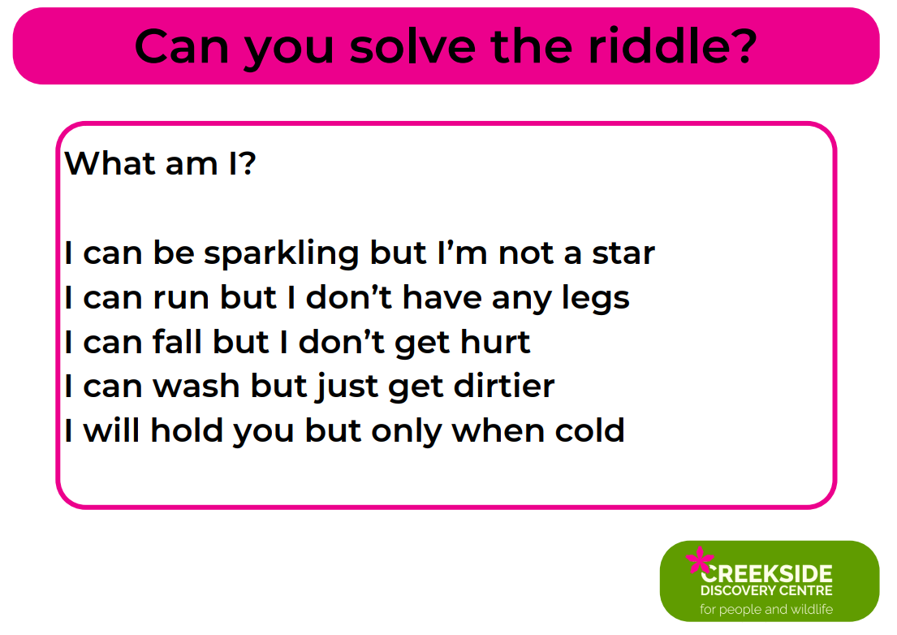
Notes:
Water

Slide 8
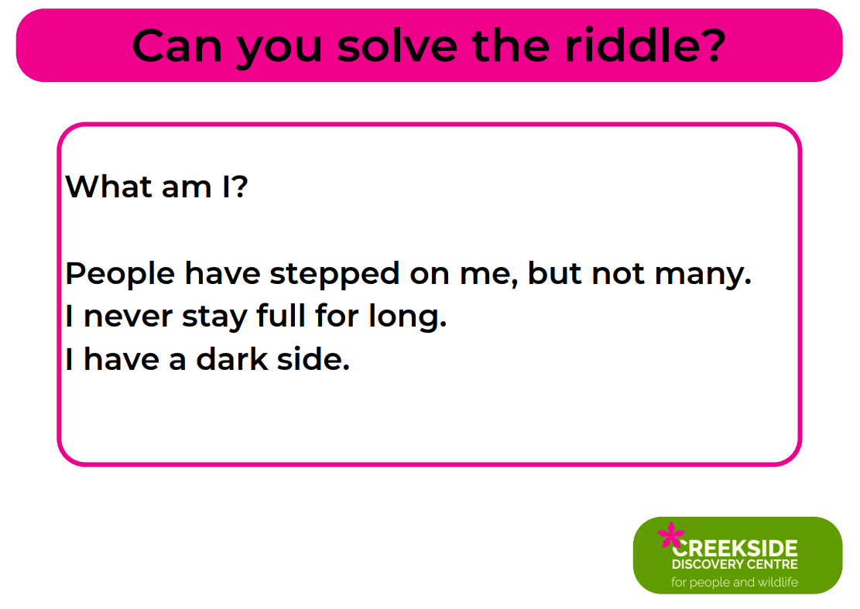
Notes:
The moon

Slide 9
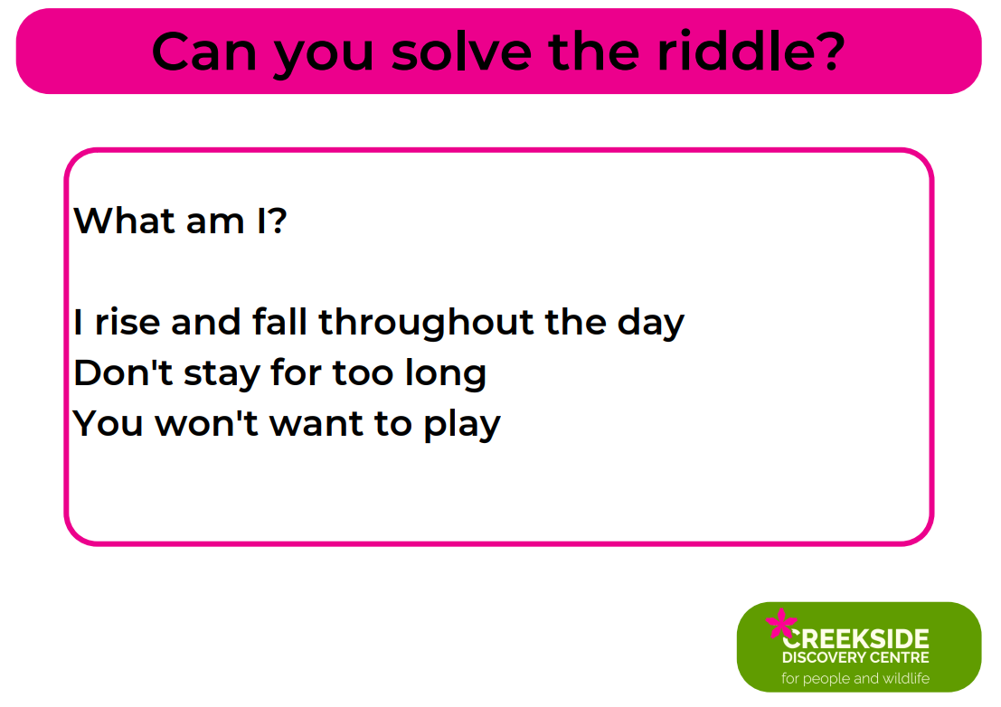
Notes:
The tide

Slide 10
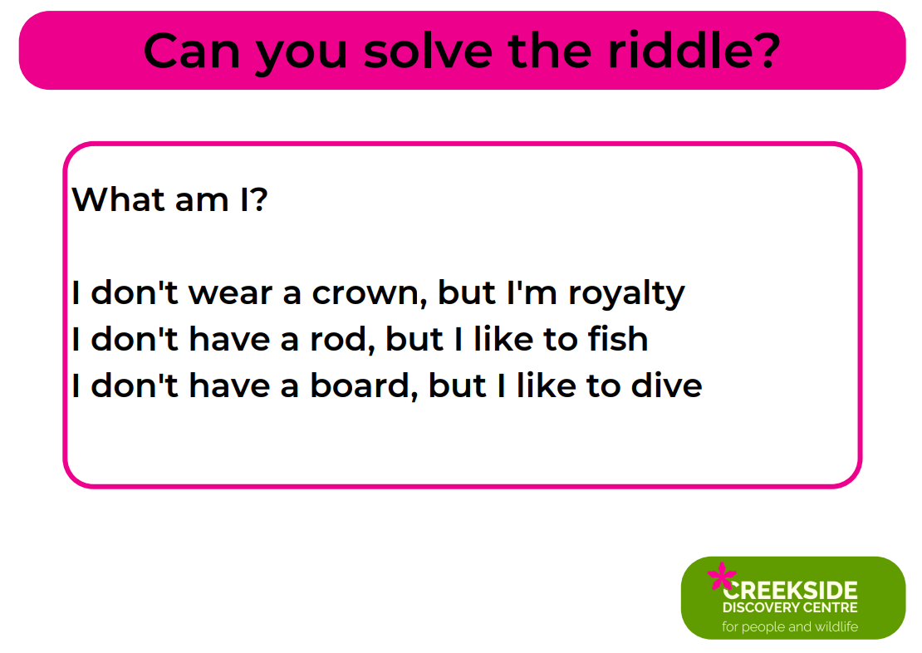
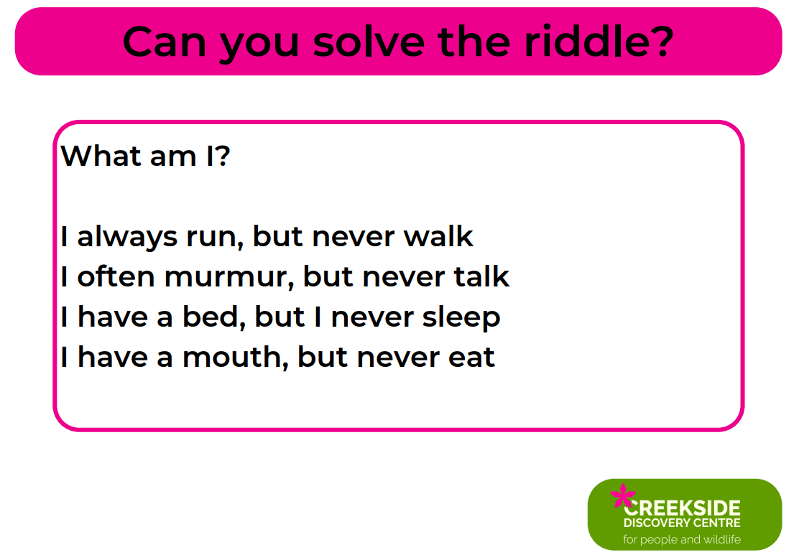
Notes:
A kingfisher

Slide 11
Notes:
A river

