Slide 1


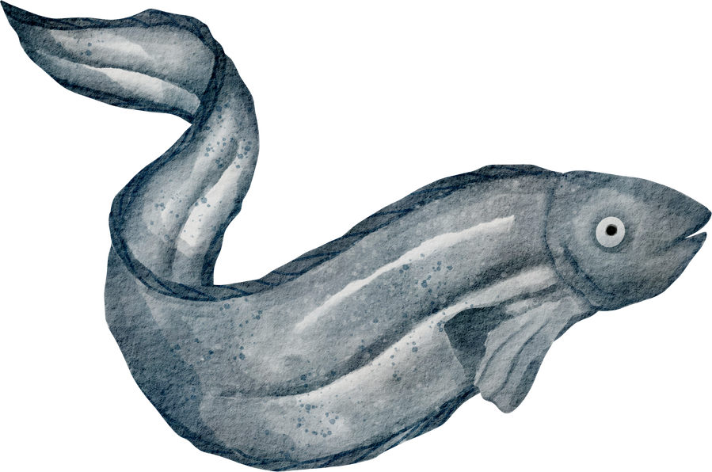
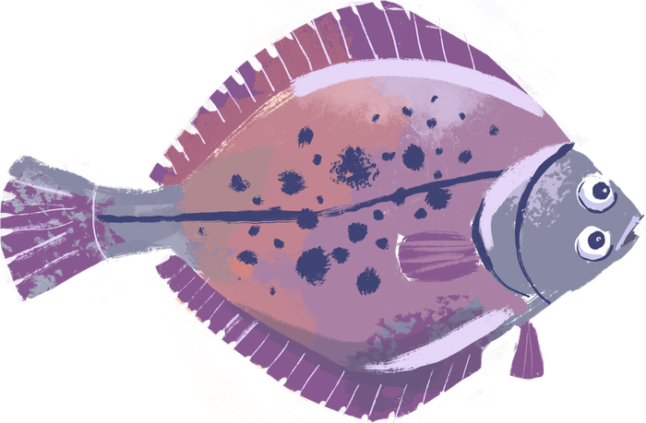

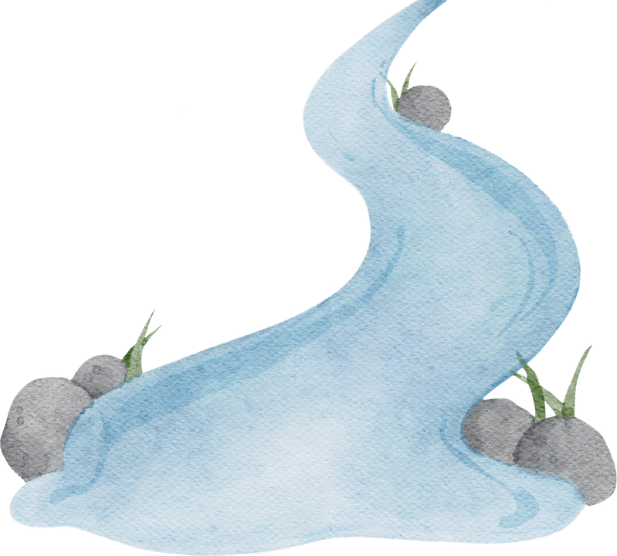
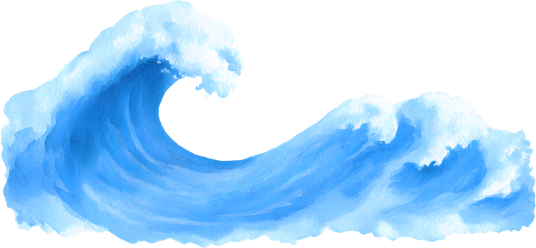
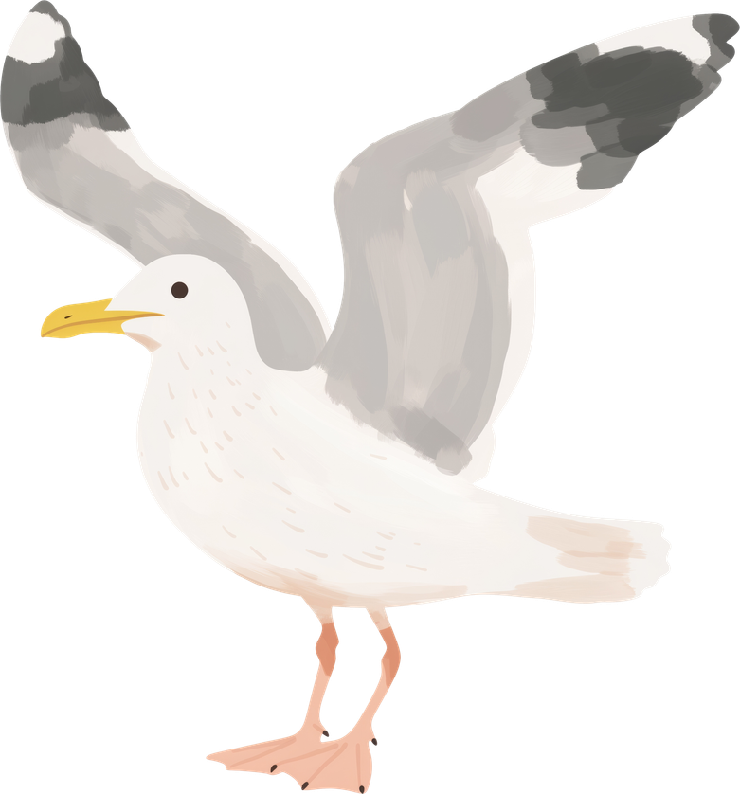

DEPTFORD CREEK
A View from the River Bank:
Learning links to enjoy in school or at home
Complete our Creekside Challenge
1) Introduction Video
2) Challenge Worksheets
Read or listen to these poems. Enjoy them on their own or use them as inspiration for your Creekside Challenge.
The River
by Valerie Bloom
Daughter of the Sea
by Philip Gross
The Seagulls
by Michael Rosen
The Creekside
Discovery Centre
Prepare for your visit or remember your time with us by watching our creek film
The Tidal Creek
Deptford Creek flows into the River Thames, and the River Thames flows out into the North Sea. This means the tide is constantly going in and out of Deptford Creek. Watch our timelapse videos to see the changes that happen with the tide.
RISING TIDE FALLING TIDE

Slide 2
FAQ
What wildlife lives in Deptford Creek?
The creek is full of life, but what you may see will depend on the time year. Learn more about one amazing creature here and find out how we help the resident swans here.
What’s that green stuff on the mud?
It’s ALGAE and we’re studying it with some friends. Find out more here and here.
What’s it like to work at Creekside Discovery Centre?
One of our work experience students can tell you all about that!
What plants grow around the creek?
More than we can tell you about here. Conservationist Nick is an expert on the international plant life of Deptford.
Plan another visit to Creekside Discovery Centre - What’s On?

Slide 3
DEPTFORD CREEK
A View from the River Bank:
Learning links to enjoy in school or at home
If you can’t access our clickable links in the first page, you can find all the same information by following these instructions and using the links below.
Creekside Challenge
https://www.creeksidecentre.org.uk/education/learning-resources/
Click on the ‘Learning about rivers’ button and you’ll find the introduction video along with a link to the PDF worksheets.
Poems
Children’s Poetry Archive: https://childrens.poetryarchive.org/
The River by Valerie Bloom: https://childrens.poetryarchive.org/poem/the-river/
Daughter of the Sea by Philip Gross:
https://childrens.poetryarchive.org/poem/daughter-of-the-sea/
The Seagulls by Michael Rosen: https://childrens.poetryarchive.org/poem/the-seagulls/
Videos: Look at the ‘Creekside Discovery Centre’ channel on YouTube
(@creeksidediscoverycentre7340)
Introduction Video: https://www.youtube.com/watch?v=kPsUjxyYQ6o
Rising Tide: https://www.youtube.com/watch?v=ELTPs7-UkmA
Falling Tide: https://www.youtube.com/watch?v=qamds-wRUYM

Slide 4
FAQ - Check out our Blog: https://www.creeksidecentre.org.uk/blog/
FAQ – Wildlife:
European Eel: https://www.creeksidecentre.org.uk/blog/post/from-river-to-sea-the-epic-journey-of-european-eels
Swan’s Nest: https://www.creeksidecentre.org.uk/blog/post/swan-nesting-raft-rebuild
FAQ – Algae 1: https://www.creeksidecentre.org.uk/blog/post/slimewatch-2-algae-investigation---photo-reportage
FAQ – Algae 2: https://sway.cloud.microsoft/uhvB7qAdFzj6v1SY
FAQ – Work Experience: https://www.creeksidecentre.org.uk/blog/post/my-work-experience-at-creekside-discovery-centre
FAQ – Plantlife: https://www.creeksidecentre.org.uk/blog/post/creekside-chronicles-nick-conservationist--the-whole-wild-world
Plan your next visit to Creekside Discovery Centre
What’s On Page: https://www.creeksidecentre.org.uk/events/

